Slide 1
Distributed Control and Automation Framework (DCAF)
Dynamic Modules
Instructor’s name
Instructor’s role
Notes:
Contributors:
Benjamin Celis
Simon Perez
Andres Gomez

Slide 2
Agenda
Creating a Dynamic Module
Modifying Configuration Class
Modifying Runtime Class
Modifying Editor Node Class
Quiz

Slide 3
Creating a Dynamic Module

Slide 4
Static or Dynamic
Static
Module developer defines the number of channels available in the module
Template includes UI ready to use.
Easier to Create
Mostly used for processing
Dynamic
Final user can configure the number of channels.
More flexible template
Requires more codding.
More commonly used for input/output

Slide 5
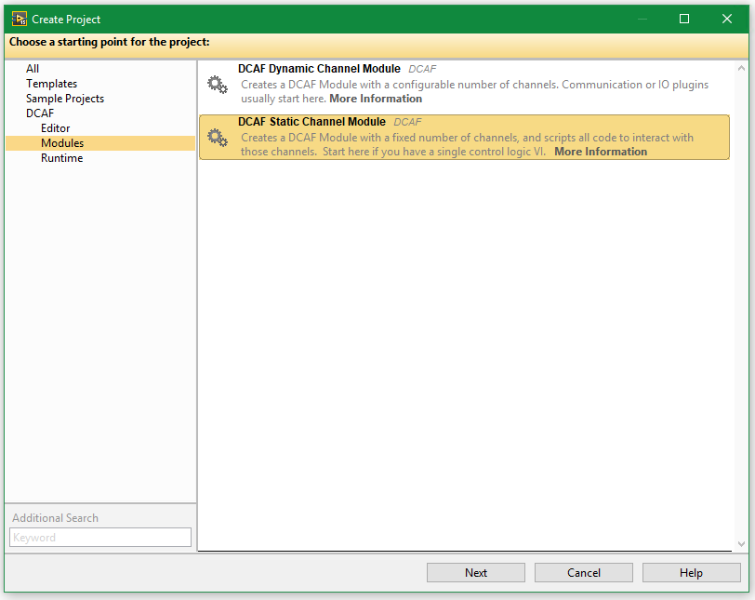
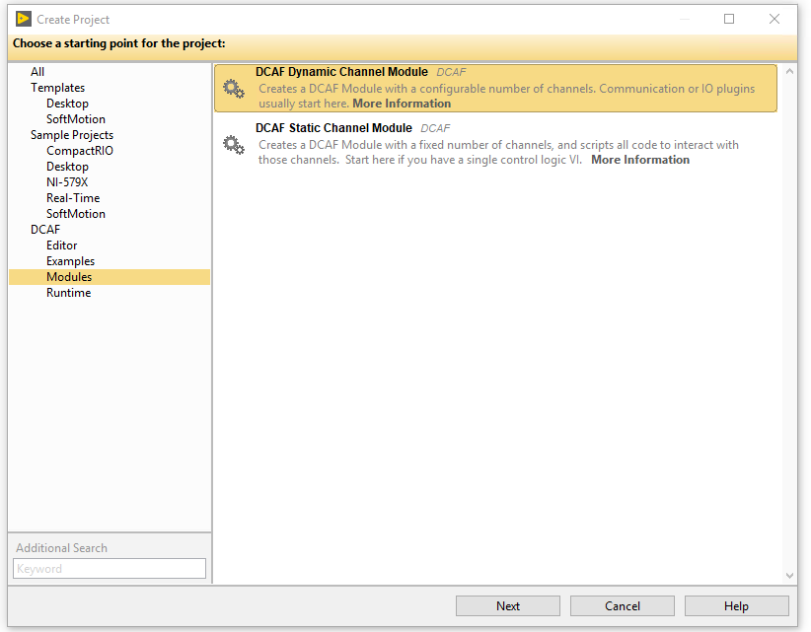
Creating a Dynamic Module

Slide 6
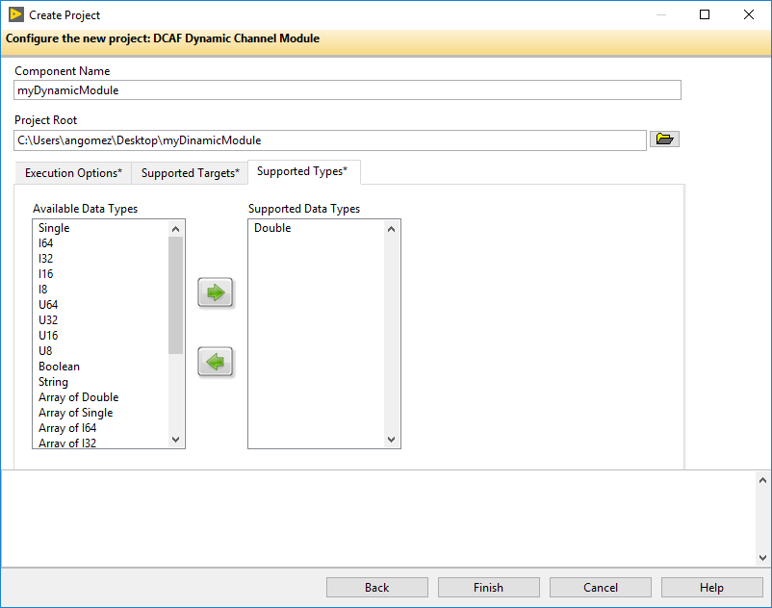
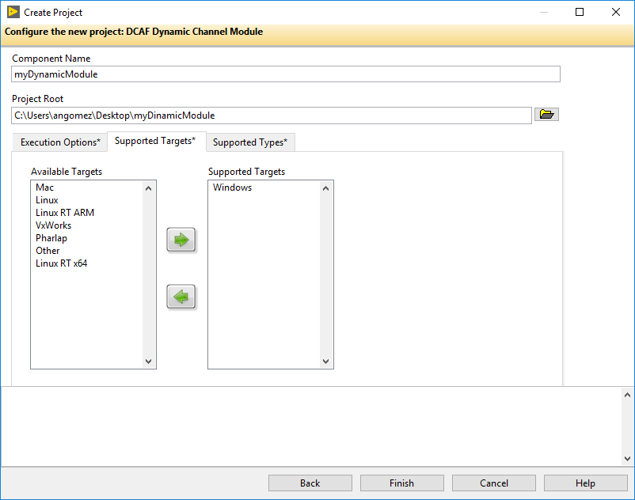
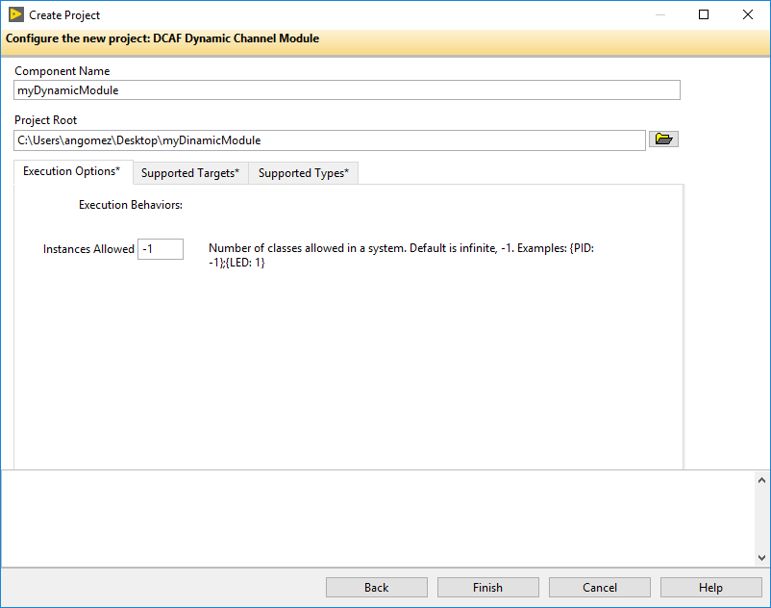
Creating a Dynamic Module

Slide 7
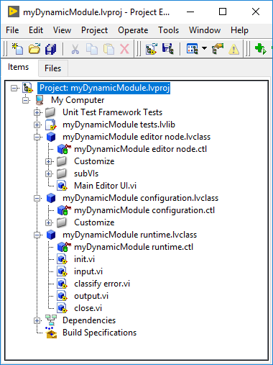
Creating a Dynamic Module
Runtime Class: Implements desired functionality for our module once it is deployed along with the DCAF engine.
Editor Node Class: Implements code that gets called by the editor for the user to configure the module.
Configuration Class: Contains code used by the editor to store the module configuration and by the engine to retrieve it. Saves several settings related to the module.

Slide 8
Modifying Configuration Class

Slide 9
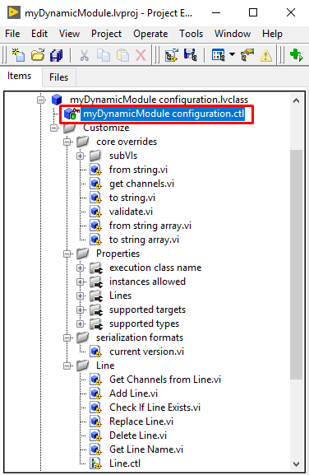
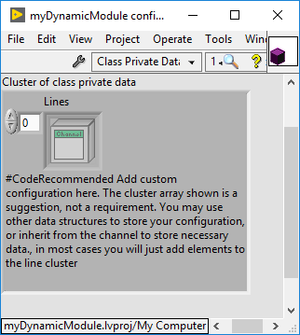
Configuration Class: Private Data
Notes:
By default, the configuration class private data will contain an array of Lines. We will learn what Lines are in the next slides.
We should also modify this private data to contain other elements our module may need to operate like general parameters that apply for the module overall.

Slide 10
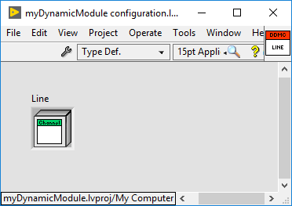
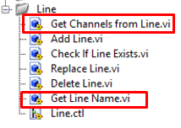
What is a Line?
A Line in DCAF is a logical grouping of one or more channels and their data or name; an instance of 1 of whatever the module “does”.
By default, a Line is a cluster with a Channel
Modules can have multiple lines
There are pre-existing VIs that operate on lines.
Notes:
From the VIs in the Line folder, we typically should modify Get Channels from Line.vi and Get Line Name.vi.

Slide 11
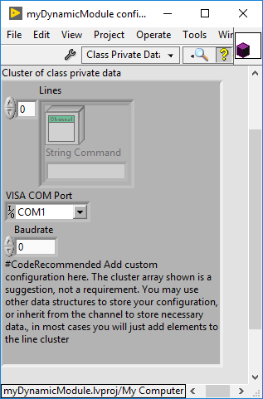
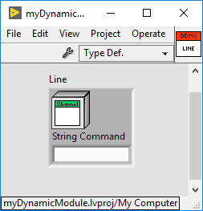
Example - What Line and Configurations Do I Need?
Read unknown number of channels from external hardware that communicates through RS232.
Channel information is requested with a string command that is specific for each value to read.
COM port and serial baudrate needs to be configurable.
Notes:
Let the students be the ones trying to answer this question. We want them to try identifying what should be the content of each line and the extra parameters to add in the configuration class private data.

Slide 12
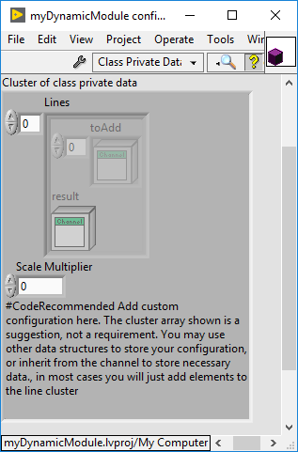
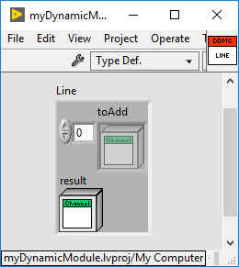
Example - What Line and Configurations Do I Need?
Module with unknown number of adders.
Each adder can take an unknown number of inputs and generates one output.
The final result for each adder is scaled with a parameter multiplier that is the same for all the adders.
Notes:
Let the students be the ones trying to answer this question. We want them to try identifying what should be the content of each line and the extra parameters to add in the configuration class private data.

Slide 13
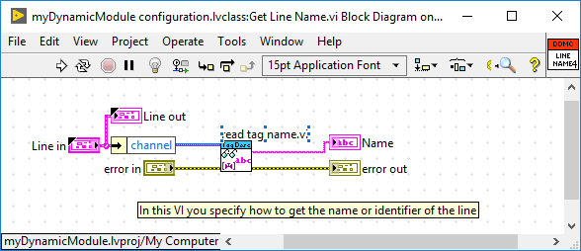
Lines Name
Each line must have a unique name.
A Line with a name that already exists in the array will not be added.
We must figure out a way to assign and read the name for each of the lines.
Modify the Get Line Name.vi to read this name.
Notes:
In several cases, we will base the name of our line in the name of one of our channels but this could change.

Slide 14
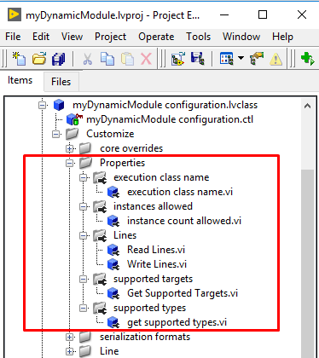
Configuration Properties

Slide 15
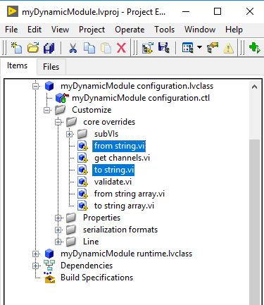
Saving and Retrieving Module Configuration
DCAF Editor saves configuration in a string similar to XML.
Each module must provide function to save and retrieve its configuration.
Developer must customize to string.vi and from string.vi

Slide 16
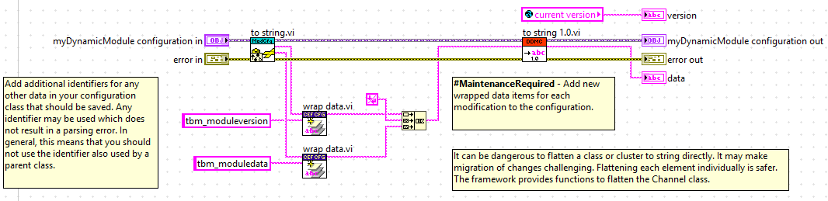
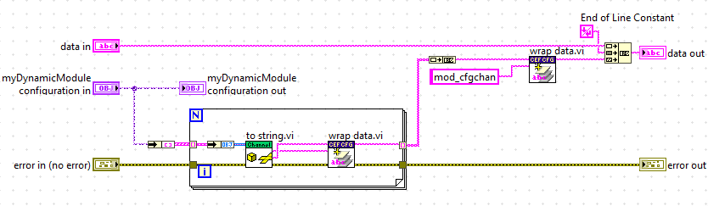
Saving Module Configuration: to string.vi
Notes:
The second image represents to string 1.0
In the first image: exists to string.vi for the tbm module parent of our module.
In the second image: exists to string.vi for a channel.
We will typically modify the to string specific to the version of the module we are working on, initially 1.0. We will need to find a way to package the information for all our channels and parameters.

Slide 17
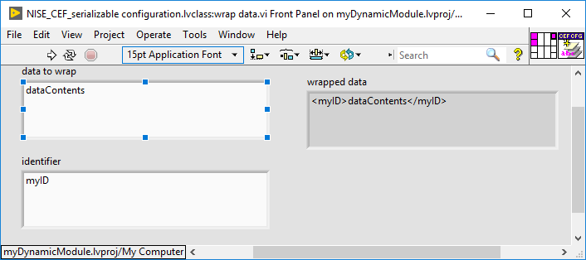
Saving Module Configuration: to string.vi
Format for string can be customized as desired.
Consider using an End of Line Constant to separate sections.
Use the wrap data.vi to package contents of data with a known identifier.

Slide 18
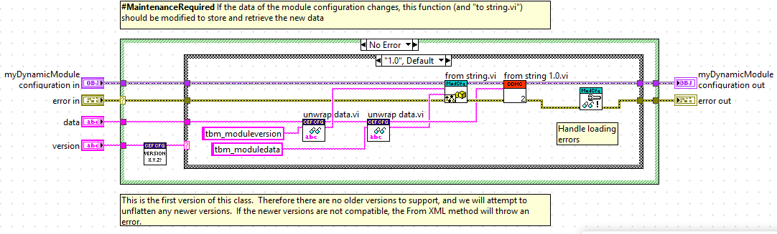
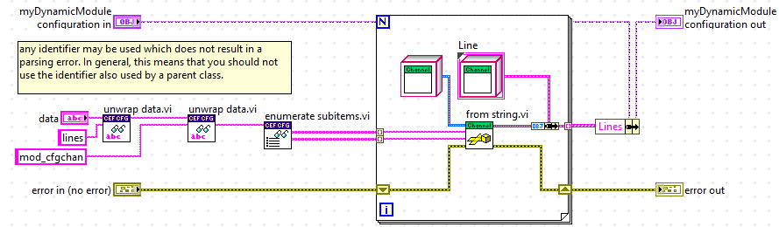
Retrieving Module Configuration: from string.vi
Notes:
The second image represents from string 1.0
In the first image: exists from string.vi for the tbm module parent of our module.
In the second image: exists from string.vi for a channel.
We will typically modify the from string specific to the version of the module we are working on, initially 1.0. We will need to find a way to de-package the information for all our channels and parameters.

Slide 19
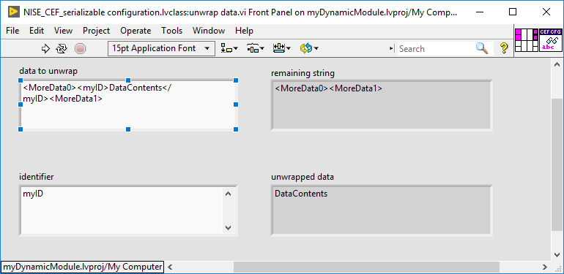
Retrieving Module Configuration: from string.vi
Build logic based on what was used in to string.vi
Use the unwrap data.vi to de-package contents of data with a known identifier.

Slide 20
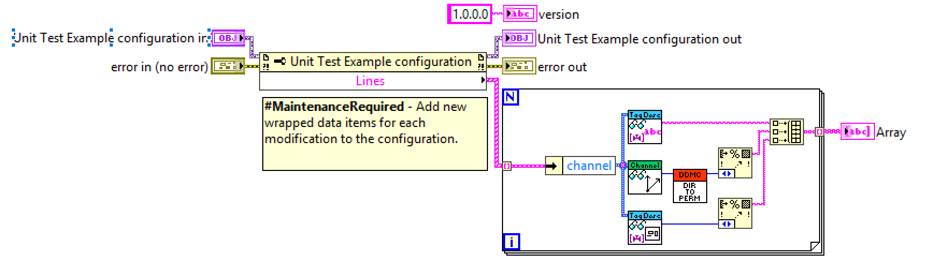
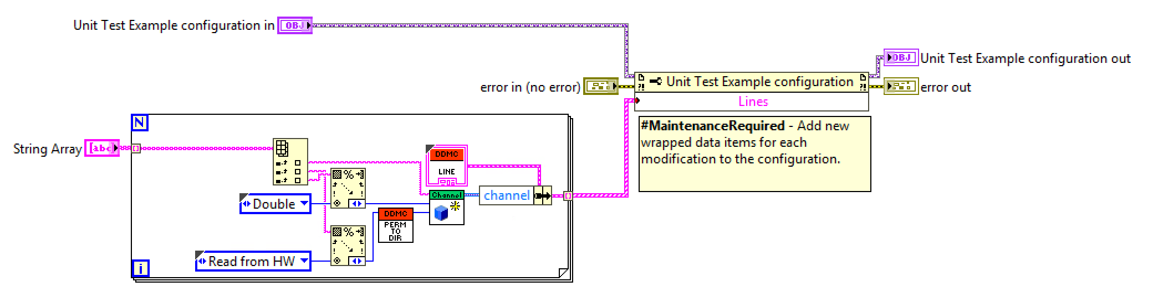
From String Array to String Array

Slide 21
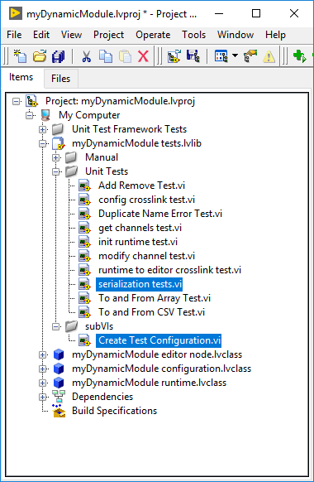
Testing the Configuration Class
Modify Create Test Configuration.vi to create a valid module example.
Run serialization tests.vi to make sure the configuration can be saved and retrieved back from a string correctly.

Slide 22
Exercise: Multiplexer Module Description
Module will select between 2 channel which will be sent to the output.
The module most support multiple multiplexers
Input Channels will be doubles, output will be double and select a Boolean.
There is a scaling multiplier that affect all modules, and multiply the output. This is defined in the configuration and has a default value of 1.
What line and configurations should we use?
How do we assign a unique name to each line?
How many channels will we need to save with ‘to string.vi’? What else needs to be saved?
Notes:
Ask questions in the slide for students to understand what they will start doing.
Line will contain 4 channels. A, B, Select and Output. In the configuration class private data we will save the Scale Multiplier.
We will name all the channels ‘LineName_ChannelName’. In this way we can easily extract the name of the line out of the name of any of the channels.
4 channels per line. Also the Scale Multiplier value.

Slide 23
Exercise
Hands On 3 Exercise 1 Part A
Notes:
https://github.com/LabVIEW-DCAF/Documentation/blob/master/Trunk/Getting%20Started%20Material/Hands%20On/Hands-On_3/DCAF_Hands_On_3.md
Students will follow the instructions to finish
Hands On 3: Exercise 1: Part A: Dynamic Module Creation and Configuration
Estimated Time: 45 minutes.

Slide 24
Modifying Runtime Class

Slide 25
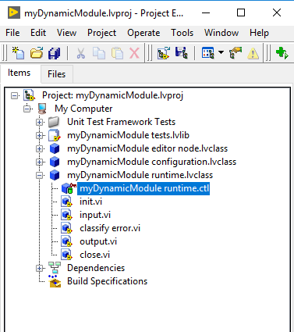
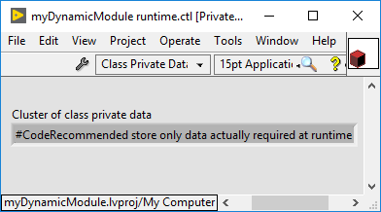
Runtime Class: Private Data
Notes:
By default, the runtime class private data will be empty.
For most applications, we will end up saving here some sort of structure to map our channels with the tag bus. We will also store parameters that configure the module.
This type of elements use to be written in initialization and used in runtime.
We can also save internal data for the runtime for this to be reused in the next iteration of the module.

Slide 26
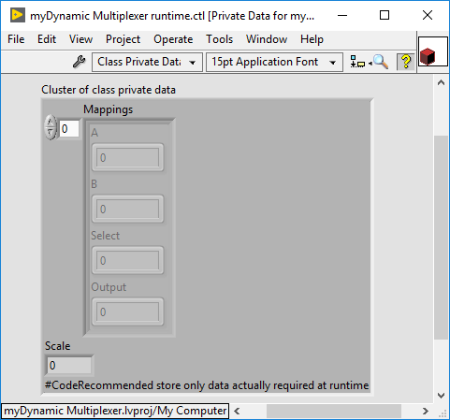
Runtime Class: Private Data for Multiplexer
Notes:
We store the Scale Multiplier.
We store an array with mappings (one element per line). Each mappings cluster contains the index to access the specific channel from the Tag Bus.

Slide 27
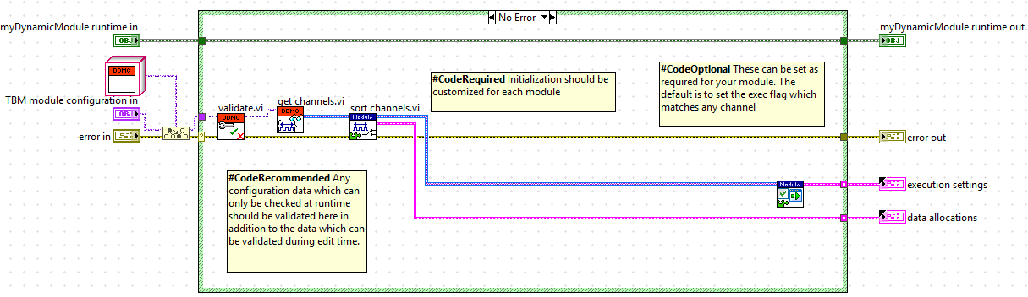
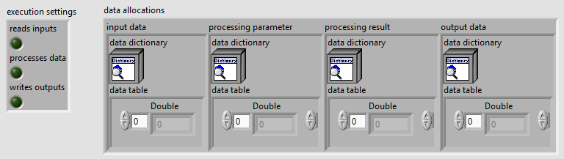
Runtime Class: init.vi
Notes:
This is how the init.vi looks like before any modification.
Further modify it to
Create some sort of mappings between data allocations and the channels we will access in runtime. This is typically stored in the runtime class.
Pass other parameters from the configuration class into the runtime class.
Initialize communication with hardware, open files, allocate memory, etc.

Slide 28
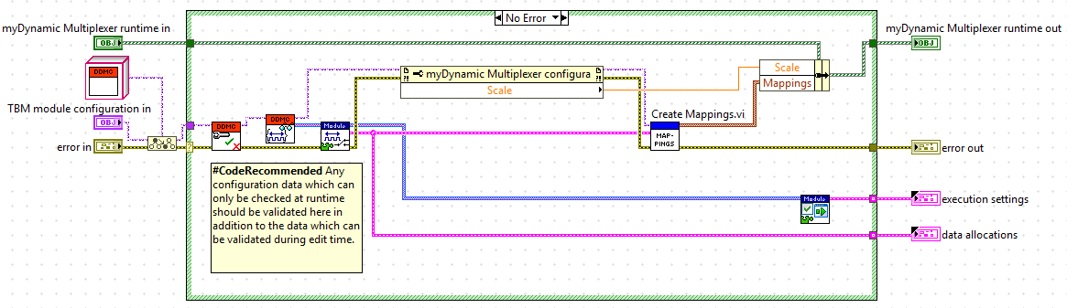
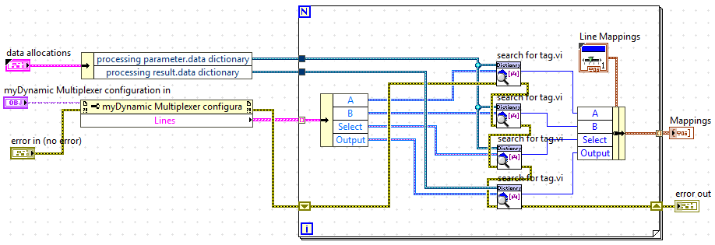
Runtime Class: init.vi for Multiplexer

Slide 29
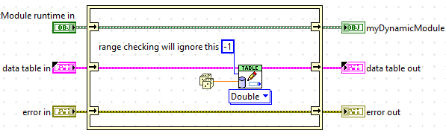
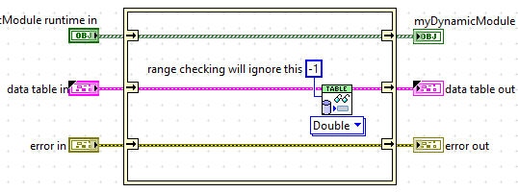
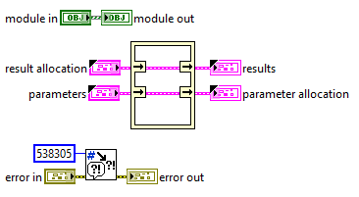
Runtime Class: input.vi, output.vi and process.vi
Notes:
This is how the VIs look like before any modification. We need to find a way to interact with the tags bus.

Slide 30
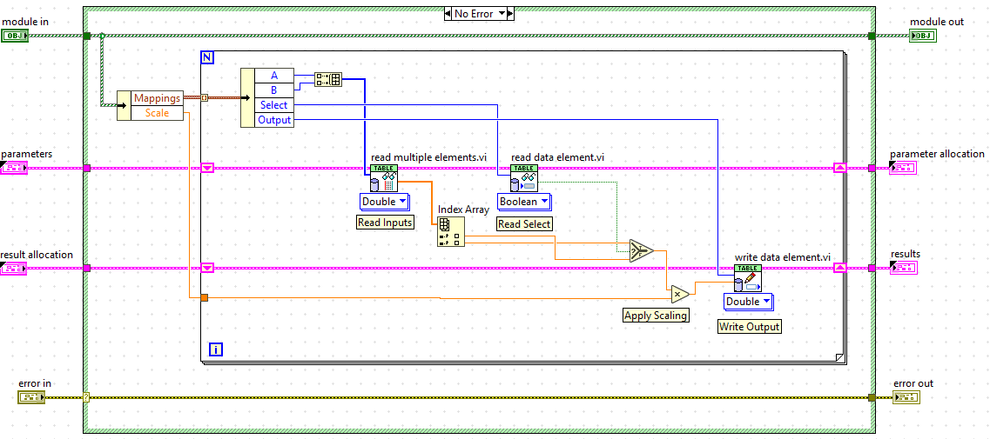
Runtime Class: process.vi for Multiplexer
Notes:
There is a for loop, one iteration per line.
For each line, we access all the channels with the previously identified indices. A and B are read in one call since both are input parameters of the same type. Result is
Saved in the results parameters bus.

Slide 31
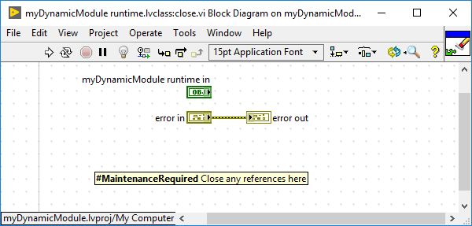
Runtime Class: close.vi
Close references, connections, release memory, etc.
Notes:
This is how the VIs look like before any modification. We use this VI to close references, connections, release memory, etc.

Slide 32
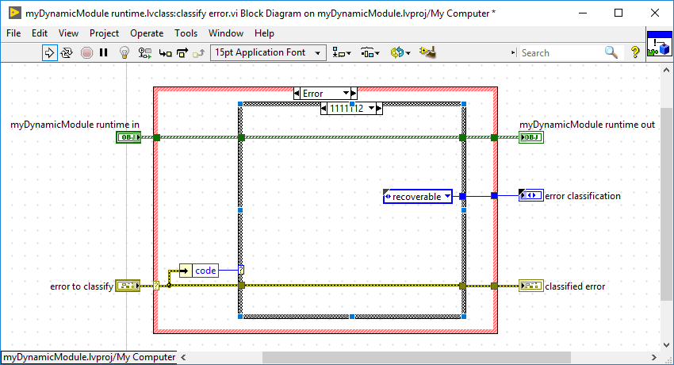
Classify Error

Slide 33
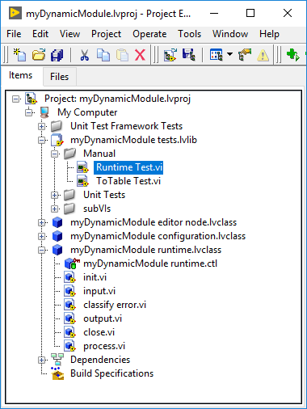
Testing the Runtime Class
Modify Runtime Test.vi to run and test the input.vi, output.vi and/or process.vi with known inputs and outputs and see the results.

Slide 34
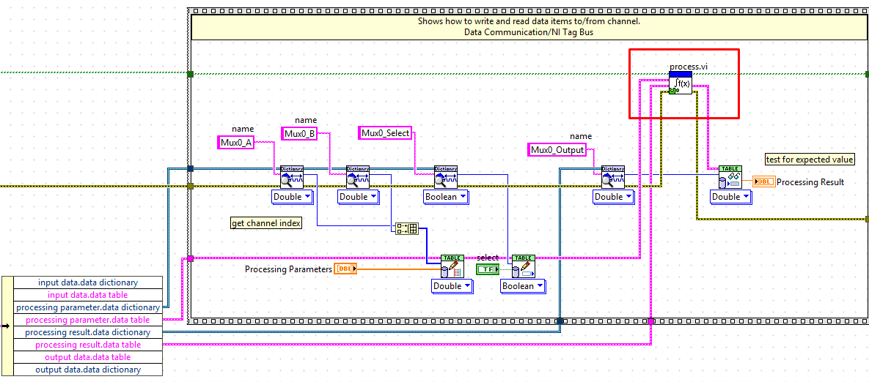
Testing the Runtime Class for Multiplexer

Slide 35
Exercise
Hands On 3 Exercise 1 Part B
Notes:
https://github.com/LabVIEW-DCAF/Documentation/blob/master/Trunk/Getting%20Started%20Material/Hands%20On/Hands-On_3/DCAF_Hands_On_3.md
Students will follow the instructions to finish
Hands On 3: Exercise 1: Part B: Dynamic Module Runtime
Estimated Time: 30 minutes.

Slide 36
Modifying Editor Node Class
Notes:
ToTable
Generate default line
Line Configuration Dialog

Slide 37
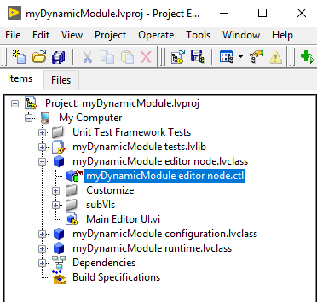
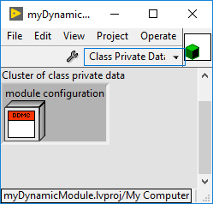
Editor Node Class: Private Data
Notes:
By default, the editor node class contains the configuration class of the module itself. In this way, the configuration class can be modified as the user configures their changes and can get saved into the configuration file using the to string functions.

Slide 38
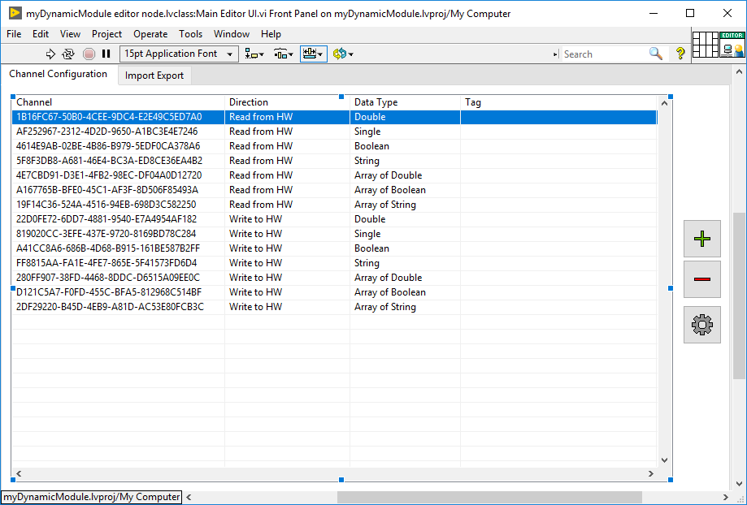
Main Editor UI
Notes:
This is how the Main Editor UI looks like by default.
Channel Configuration Tab: In here, the user will be able to configure the channels to use. Typically, each of the lines in the table will be related to a line in our module.
The columns will be the different things that are configurable for a given line. The add and remove icons in the right, are typically used to add or remove a new line from the configuration. For the add, typically a new dialog is open where the user can configure the line with more detail. The gear icon allows editing a line that is already part of the configuration.
Import Export Tab: In this tab, the user will be able to import and export the settings for the module. This requires implementing the to string array and from string array VIs.
In many cases we will add an extra tab for the user to configure static parameters or configurations for our module to operate.

Slide 39
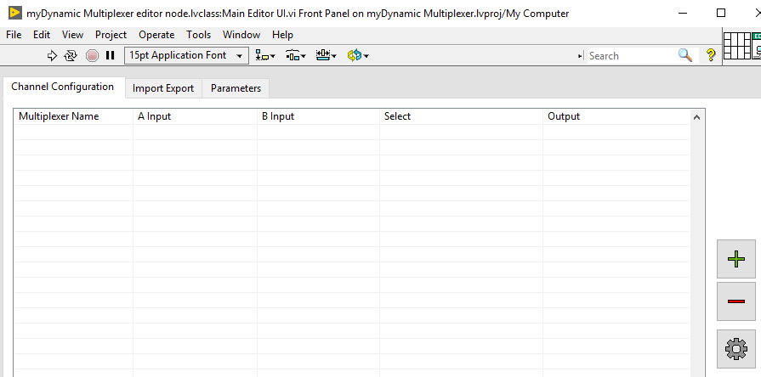
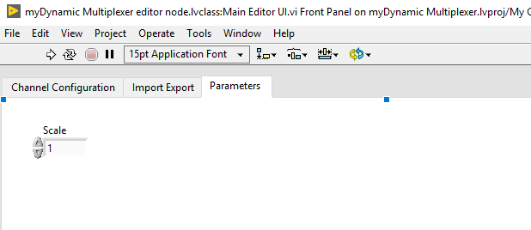
Main Editor UI for Multiplexer
Notes:
Columns: Multiplexer Name, A Input, B Input, Select Input and D Output. The name is necessary in the first column since it is used by other elements in the editor to operate.
Adding extra column for the user to configure parameters.

Slide 40
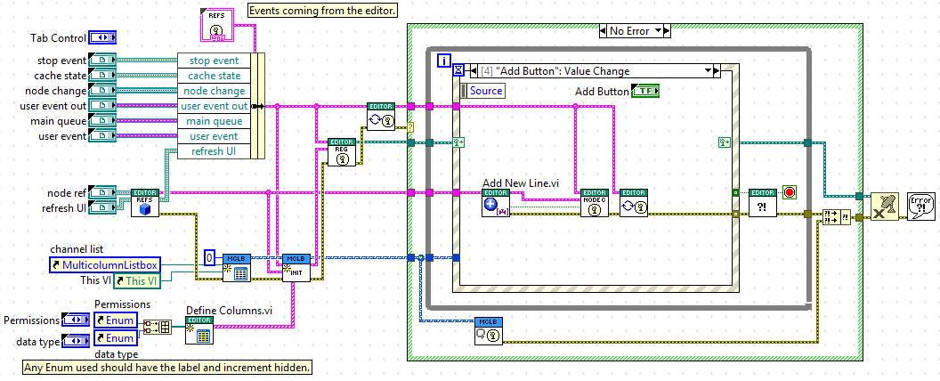
Main Editor UI
Notes:
Explain general architecture of Main Editor UI
Highlighted VIs are key VIs that need to be modified to define the behavior for the elements in each column and add new lines.

Slide 41
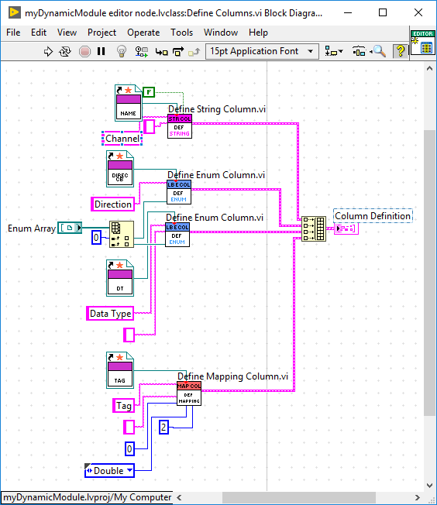
Define Columns
Defines element in each of the columns of the line.
Valid columns types are string, enum, tag mapping or custom.
Each column provides a Callback VI that runs when the column value changes.
Notes:
For the Multiplexer, we will define 4 columns as tag mappings. Only the first column will be a string representing the name of the line.

Slide 42
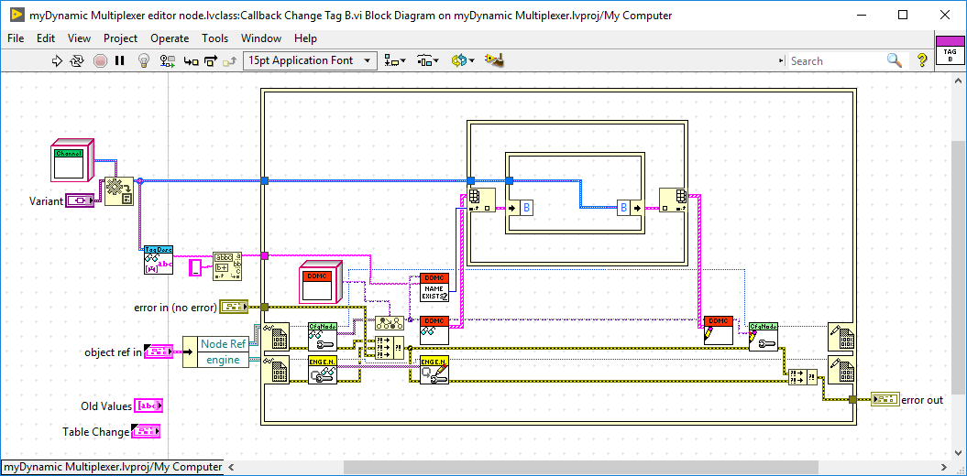
Define Columns – Callback VIs
Notes:
The new channel assigned is saved.

Slide 43
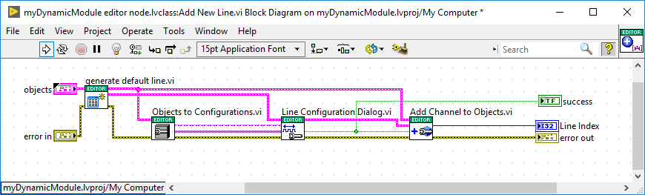
Add New Line
Executed when user adds a new line to the table
VIs to modify: generate default line.vi and Line Configuration Dialog.vi
Notes:
The new channel assigned is saved.

Slide 44

Line Configuration Dialog

Slide 45
Exercise
Hands On 3 Exercise 1 Part C and Part D
Notes:
https://github.com/LabVIEW-DCAF/Documentation/blob/master/Trunk/Getting%20Started%20Material/Hands%20On/Hands-On_3/DCAF_Hands_On_3.md
Students will follow the instructions to finish
Hands On 3: Exercise 1: Part C: Dynamic Module Editor Node
Hands On 3: Exercise 1: Part D: Create a a DCAF Application that runs the Dynamic Module
Estimated Time: ?? minutes.

Slide 46
Quiz

Slide 47
Map the class with its expected functionality
Editor Node Class
Runtime Class
Configuration Class
Contains code used by the editor to store the module configuration and by the engine to retrieve it. Saves several settings related to the module.
Implements code that gets called for the user to configure the module in a UI.
Implements desired functionality for our module once it is deployed along with the DCAF engine.
Notes:
A => 2
B => 3
C => 1

Slide 48
Map the class with its expected functionality
Editor Node Class
Runtime Class
Configuration Class
Contains code used by the editor to store the module configuration and by the engine to retrieve it. Saves several settings related to the module.
Implements code that gets called for the user to configure the module in a UI.
Implements desired functionality for our module once it is deployed along with the DCAF engine.
Notes:
A => 2
B => 3
C => 1

Slide 49
Resources

Slide 50
Resources
DCAF Developer Guide:
Chapter 4: Creating New DCAF Modules
Notes:
https://github.com/LabVIEW-DCAF/Documentation/blob/master/Trunk/Getting%20Started%20Material/devguide/ch4_Creating%20Modules.md#4-creating-new-dcaf-modules

